Slide 1
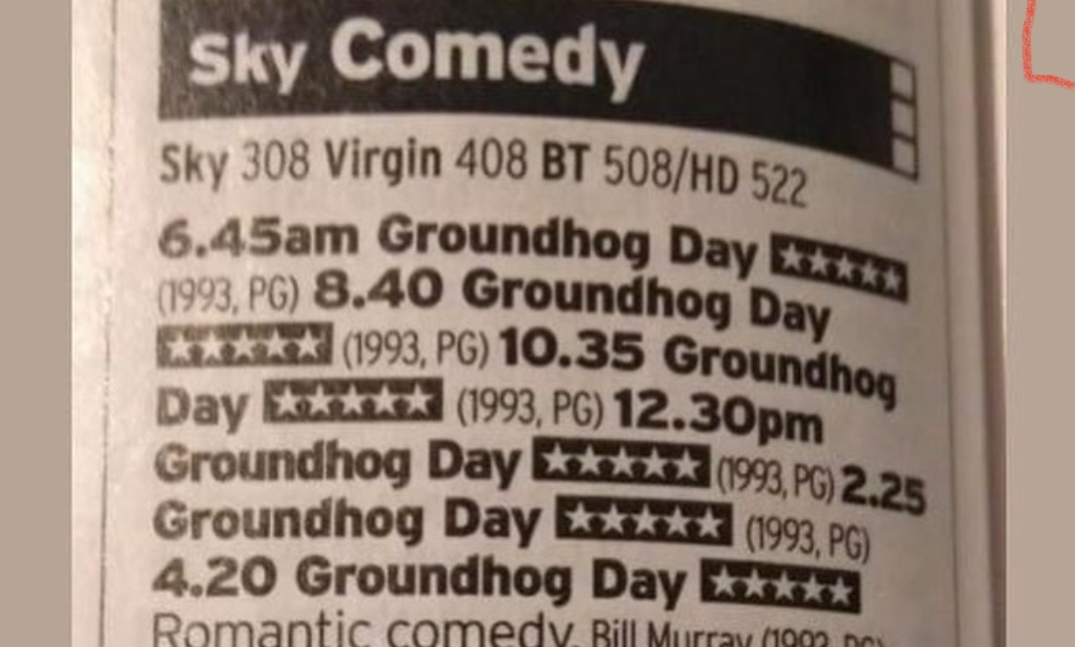
John’s quiz
Third lockdown special

Slide 2
Round 1
Multi Choice

Slide 3
Question 1
What is the pope not allowed to do with his body?
Indulge in “self pleasure”
Have piercings
Have tattoo’s
Donate an organ

Slide 4
Question 2
The first line of CONPLANN 8888, the US government’s strategy for defending against zombies, states what?
This plan can be used during a pandemic
This plan is intended for unprecedented events in the future
This plan was inspired by a movie
This plan was not actually designed as a joke

Slide 5
Question 3
Your cat is more likely to like you if you do what?
Play with them
Blink at them
Blow on them
Make purring noises

Slide 6
Question 4
In 2011, The Chambers Dictionary defined what as 'a cake, long in shape but short in duration‘?
eccles
éclair
gâteau au yaourt
sękacz

Slide 7
Question 5
Which is the most visited country in the world?
USA
Cambodia
France
UK

Slide 8
Question 6
A tree which has darker leaves than surrounding trees can indicate what
There’s a dead body buried beneath it
It is a favoured spot for later animals to urinate
It is located over a fresh water source
It is getting less sunlight

Slide 9
Question 7
A Thai national park was tired of tourists leaving their trash around campsites, so has recently started
Building temples with the bottles
Having bonfire weekends for locals
Recycling into “do not litter” signs
Mailing it back to its original owners,

Slide 10
Question 8
In 1954, Ernest Hemingway survived two plane crashes in two days. After the second crash, the writer was presumed dead, but walked out of the jungle the next day, holding what.
His plane ticket
A severed finger
A baby chimpanzee
A bottle of gin

Slide 11
Question 9
Despite repeated campaigns to repeal the law, which of these is still illegal in Sweden?
spontaneous dancing
mini skirts
busking
displaying the flag of any other country outside your home

Slide 12
Question 10
It’s almost impossible to tickle yourself, but one exception is…
The soles of your feet
The roof of your mouth
Your armpits
Your upper ribs

Slide 13
Round 2
True or False

Slide 14
Question 11
True or False?
Women fall in love more times in their lifetime than men do

Slide 15
Question 12
True or False?
There was a London society called The Farting Club whose members tried to ‘outfart’ each other

Slide 16
Question 13
True or False?
Eating polar bear liver can cause your skin to peel off and your hair to fall out.

Slide 17
Question 14
True or False?
In Japan, there’s a museum that is specifically for rocks that look like faces.

Slide 18
Question 15
True or False?
Queen Elizabeth II is older than the invention of chocolate chip cookies

Slide 19
Question 16
True or False?
Bruce Forsythe was 14 days older than sliced bread

Slide 20
Question 17
True or False?
The Romans had hot dogs

Slide 21
Question 18
True or False?
Languages that are spoken more quickly than English (like Spanish) contain more information per syllable than English.

Slide 22
Question 19
True or False?
The top native predator on the island of Montserrat is a chicken

Slide 23
Question 20
True or False?
88 percent of British people consider themselves to be among the nicest 50% of the population

Slide 24
Round 3
Short break?
Picture round

Slide 25
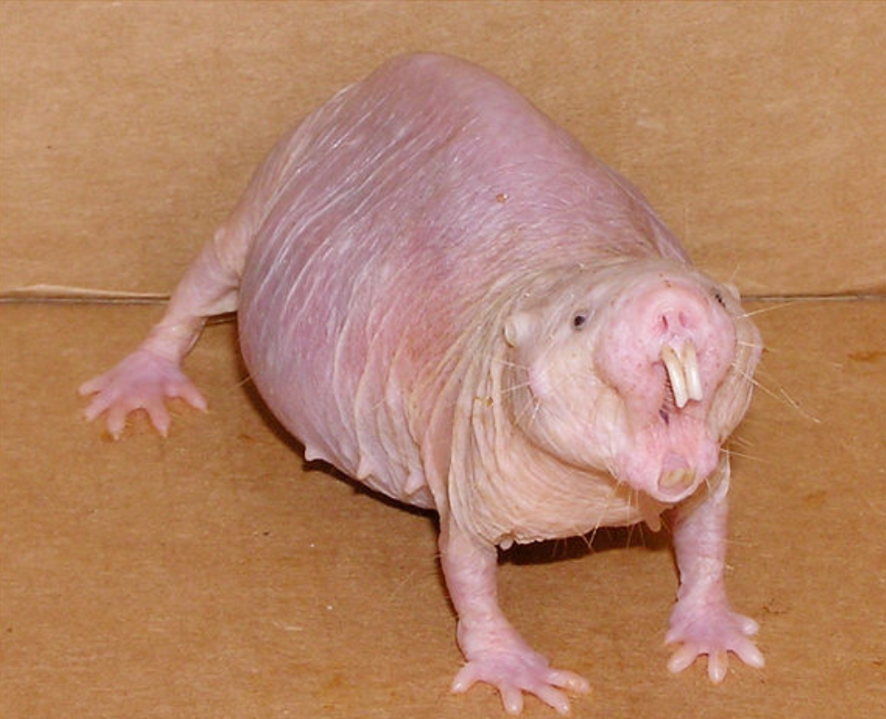
Question 21
What is this

Slide 26
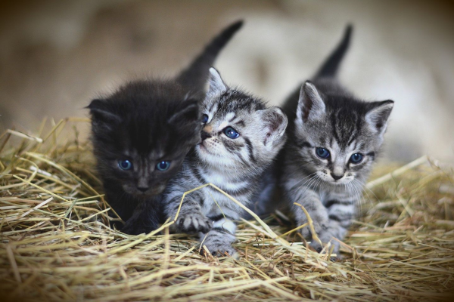
Question 22
What is a group of kittens called?

Slide 27
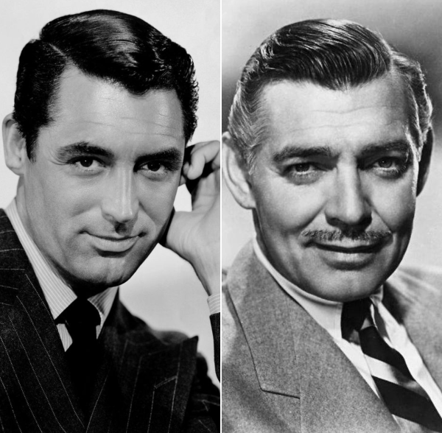
Question 23
True or False?
Cary Grant and Clark Gable met once a year to exchange unwanted monogrammed Christmas gifts

Slide 28
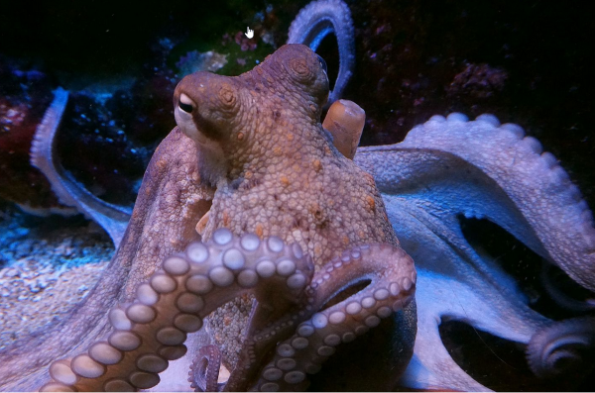
Question 24
True or False?
Octopus
sometimes
tickle fish

Slide 29
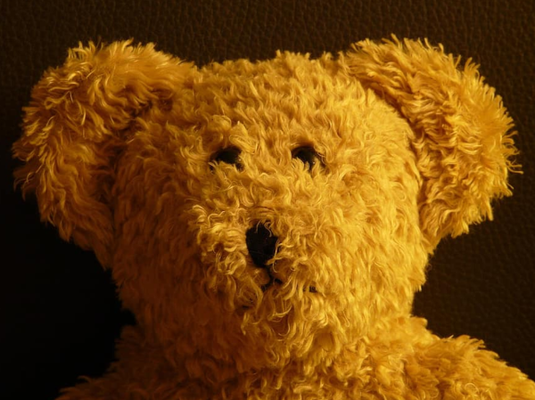
Question 25
What percentage of British adult say they still sleep with a cuddly toy
10%
25%
33%
50%

Slide 30
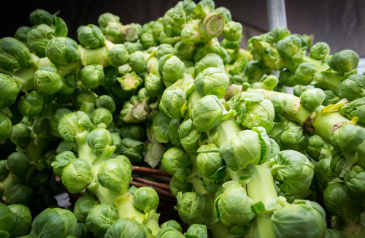
Question 26
True or false?
Brussels sprouts really did taste worse when you were a child

Slide 31
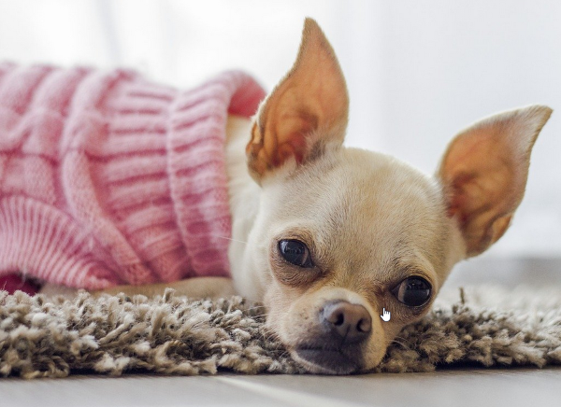
Question 27
True or false?
In 2019, a Spanish town was terrorized by a pack of wild chihuahuas.

Slide 32
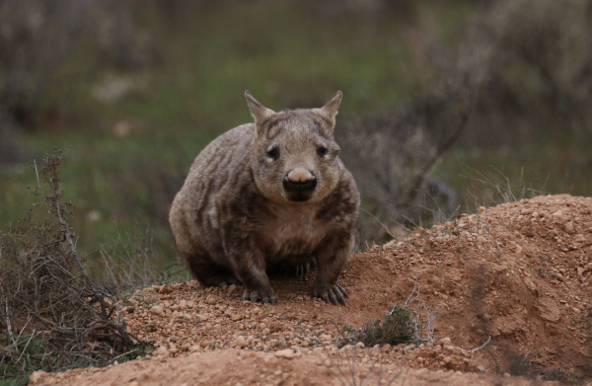
Question 28
What is this?

Slide 33

Question 29
What is missing from this headline

Slide 34
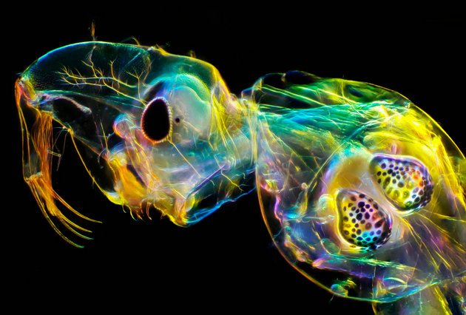
Question 30
True or false? This is a living organism

Slide 35
Round 4
Any other business

Slide 36
Question 31
The day recreational marijuana was legalised in a Canada, a 9 year old girl scout in Edmonton did what outside a newly opened weed shop?

Slide 37
Question 32
During the 1980s how many different singles took the UK chart number 1 spot?
Nearest one wins

Slide 38
Question 33
Occam’s broom is a term coined by the biologist Sidney Brenner to describe what?

Slide 39
Question 34
True or False?
Children are more likely to be arachnophobic after they watch a Spider-Man film

Slide 40
Question 35
True or False
Farts are strong enough to propel humans in zero gravity.

Slide 41
Question 36
True or False?
2021 will be the shortest year in nearly a century.

Slide 42
Question 37
Wiltshire invested in a new fleet of gritters in late 2019. Which of these is not a gritters‘ chosen name?
Sir David Attenbrrrr
Thaw Enforcement
Gary Gritter
Spready Mercury

Slide 43
Question 38
Which if these is a piece of advice from ‘The Rules of Dancing’, a book from 1529 about dance etiquette
Never fart when you are dancing
A smile is as important as proper footwear
Always glance your partners gaze
Bow low before dancing commences

Slide 44
Question 39
The TV series Star Trek, first aired in 1967, has spawned nine television series and one short-form companion series that make up the bulk of the Star Trek mythos across 37 seasons of television
How many episodes are there is total?
(nearest one wins)

Slide 45
Question 40
True or False?
Smarter people drink more.

Slide 46
Time for a break
That’s the end of the quiz

